Slide 1

Wealth & Health in the World
Ironhack 09/2022
Project W9
Ignace GRAVEREAUX

Slide 2
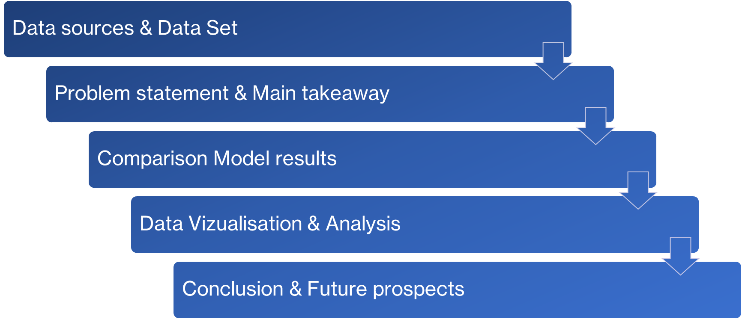
Content

Slide 3

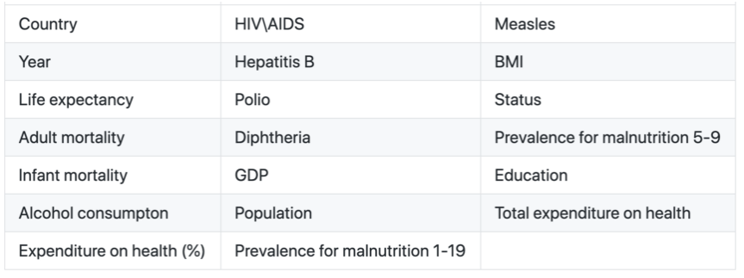
Data sources & Data Set
Source :
  Health Nutrition and Population Statistics / Doing Business /Statistical Capacity Indicators
  Online at: https://data.worldbank.org
3 Dataset
  Rows :
    152 countries + years (1995-2021)
  Columns
    373 +54 Features (columns)
    Output
      Health : Life expectancy (years)
      Wealth : GDP / Capita (PPP $)
      Health * Wealth

Slide 4


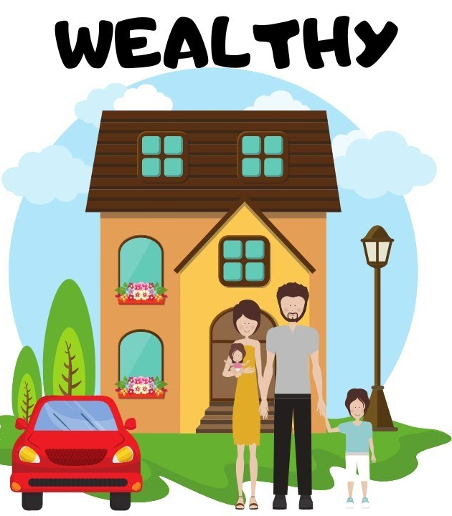

Problem statement & Main takeaway
Context:
  Life expectancy is the fundamental metric for assessing population health.
  Wealth is measured as GDP/capita in Purchasing Power Parity (PPP) for each country
Scope :
  Countries with a sufficiently high GDP and with correctly recorded statistics
  Year : 2004-2016
Problem statement:
  How can countries better allocate their limited resources
    To improve overall life expectancy for their population?
    To have a richer population ?
Main takeaway (features which impacts) :
  Health : Mortality rate (infant)
  Wealth : % international migrant
  Both : Electricity power demand
Notes:
Purchasing power parity (PPP) is a money conversion rate used to express the purchasing powers of different currencies in common units.
The intent of this project was to get a better understanding of the relationship between various public health factors and global life expectancy. How can countries better allocate their limited resources to improve overall life expectancy for their population? And to have a richer society ?

Slide 5
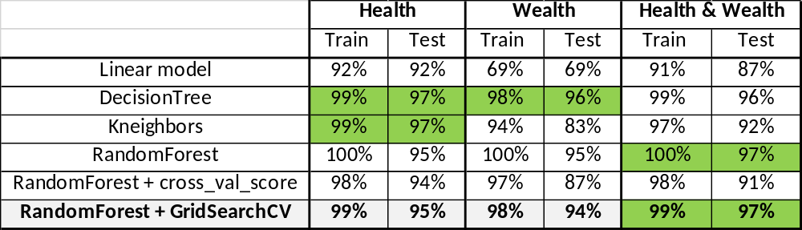
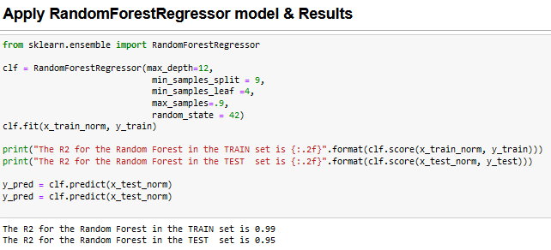
Comparison Regression Models results

Slide 6
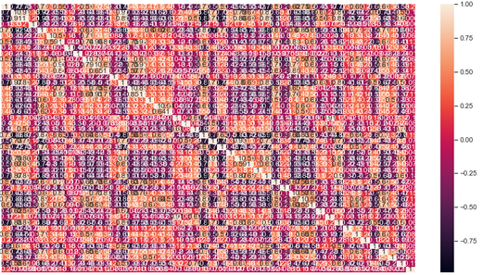
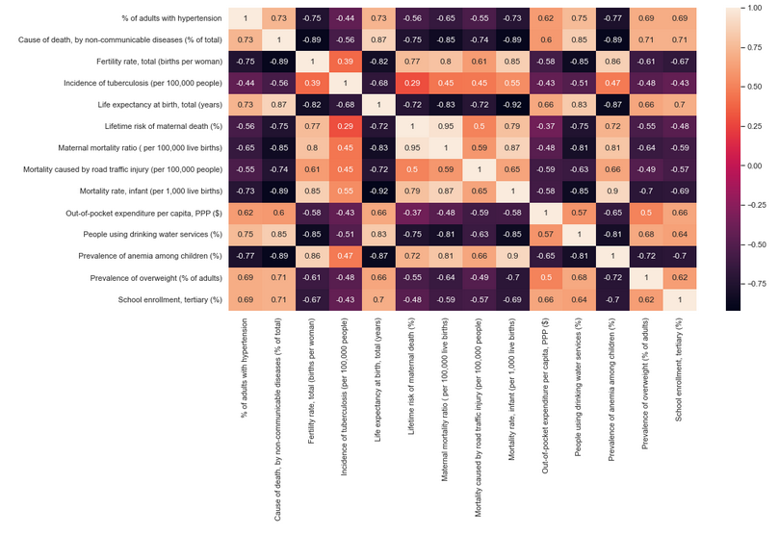
Comparison Regression Models results
Heatmap for Health : Life expectancy

Slide 7
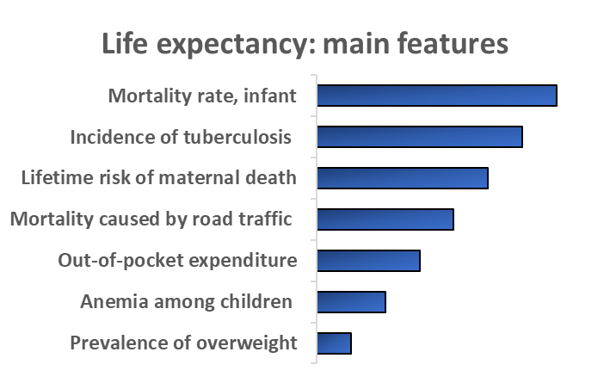

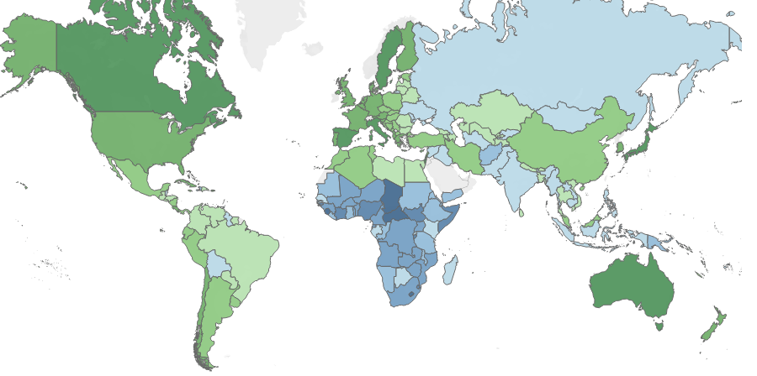
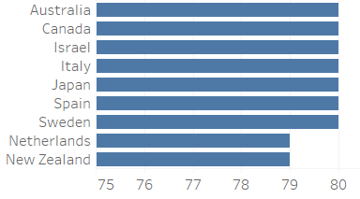
Data Vizualisation & Analysis
HEALTH : Life expectancy (years) in the world
Life expectancy in years (2016)
Highest Rate

Slide 8
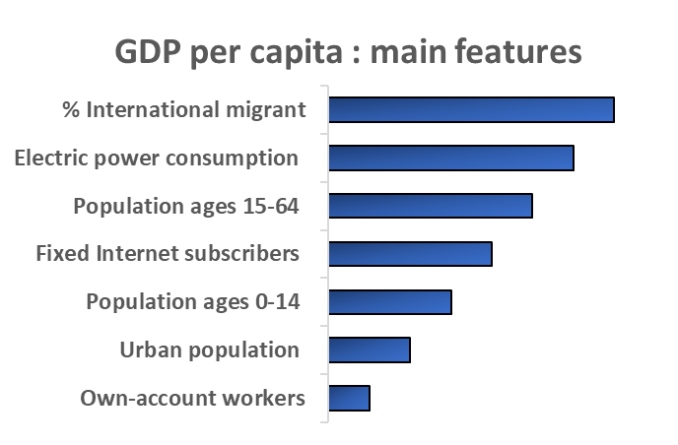

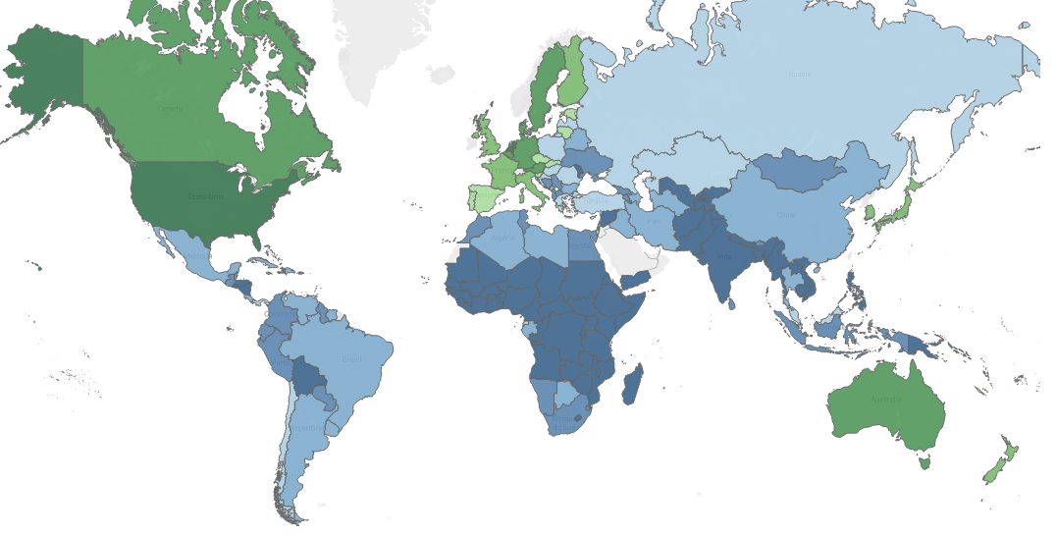
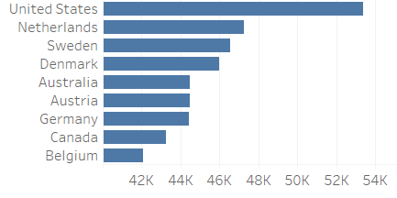
Data Vizualisation & Analysis
WEALTH : GDP per capita (PPP $)
GDP per capita (PPP $ 2016)
Highest Rate

Slide 9

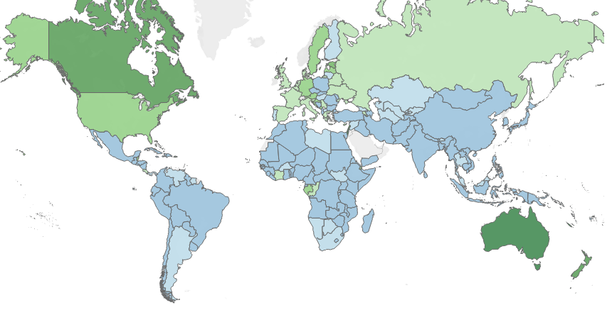
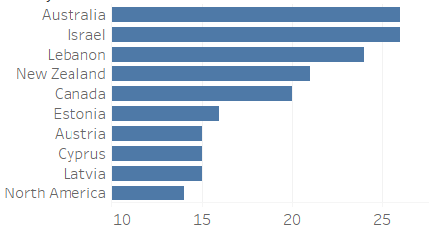
Data Vizualisation & Analysis
WEALTH : % Migrant in each country
% International Migrant (2016)
Highest rate

Slide 10
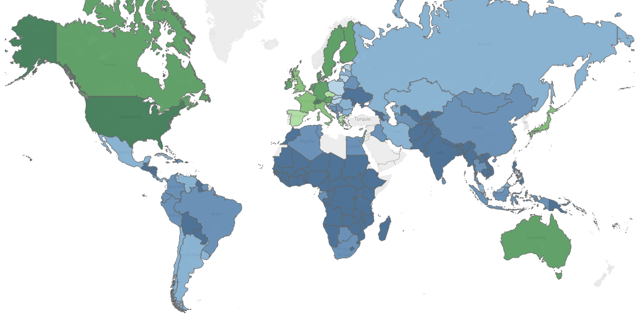
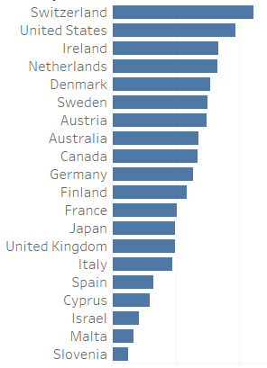
Data Vizualisation & Analysis
HEALTHY & WEALTHY
Life expectancy and GDP per capita combined
Highest rate

Slide 11
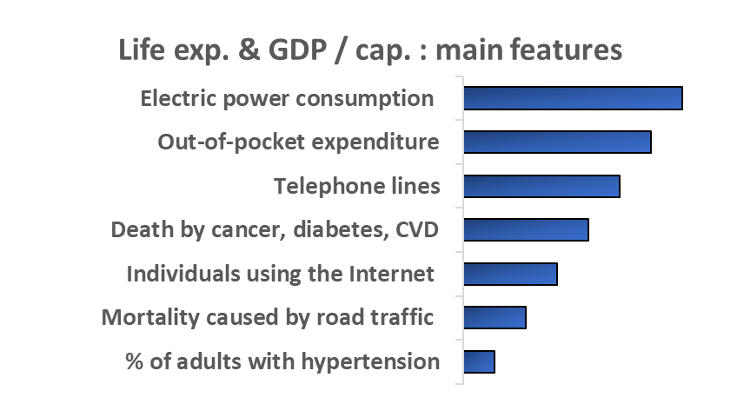

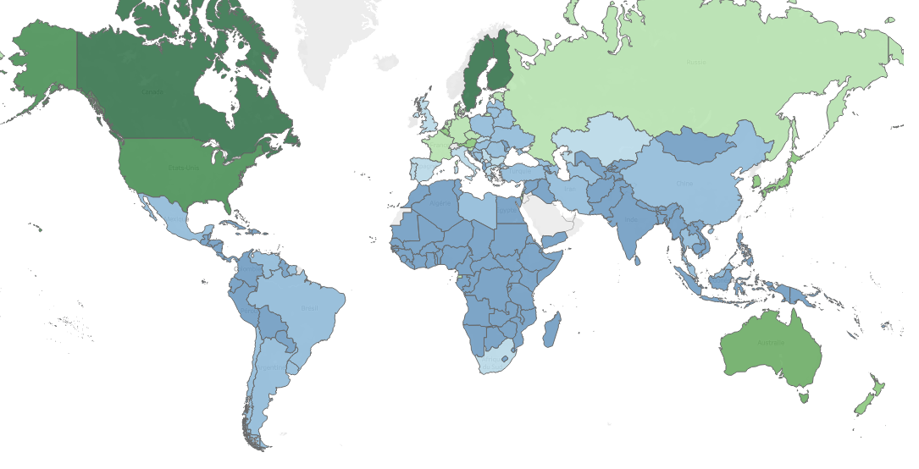
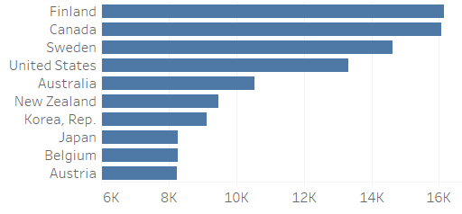
Data Vizualisation & Analysis
HEALTH & WEALTH : Electricity consumption
Electricity consumption (TWH2016)
Highest rate

Slide 12
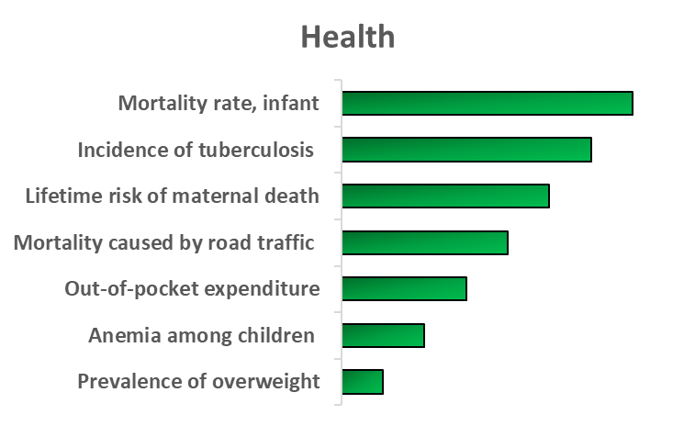
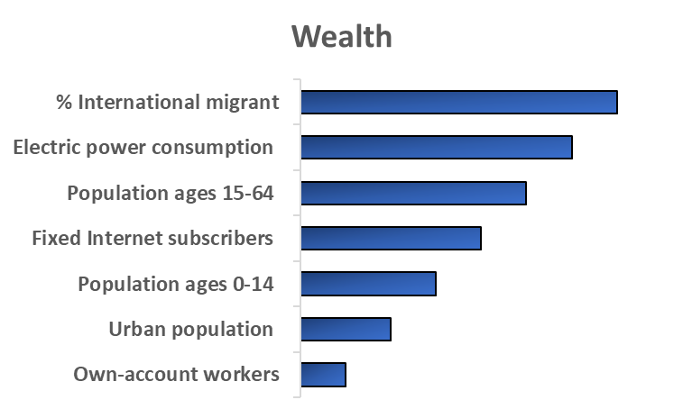
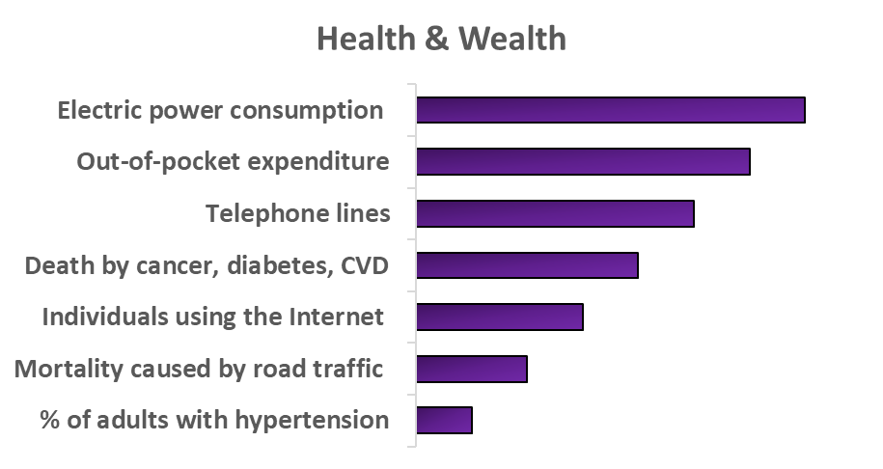
Main Features to predict Health / Wealth / Health&Wealth

Slide 13
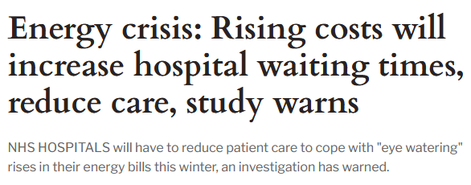
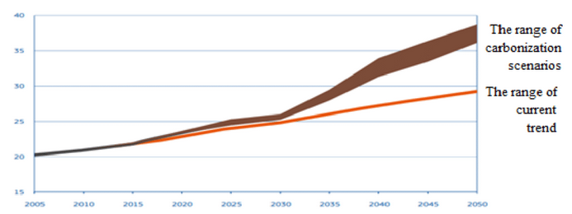
Conclusion & Future prospects
Main takeaway
  Health: Developing nations still lack fundamental resources while established nations may have completely different issues such as cardiovascular disease and cancer.
  Wealth: As a nation, the best way to be rich is first to attract new international talent, to have good infrastructure and a large share of the working population.
  Health&Wealth : Energy (Electricity consumption) remains the 1 first factor
Future prospects :

